Slide 1
SCRUM Fundamentals

Slide 2
Agenda
Agile Intro
SCRUM intro
SCRUM Framework
Roles
Time boxes
Artifacts
Definition of “Done”

Slide 3
Agile intro

Slide 4
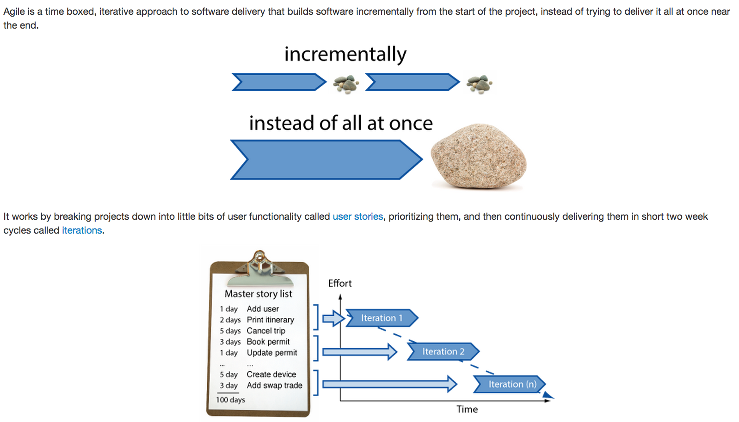
Agile intro

Slide 5
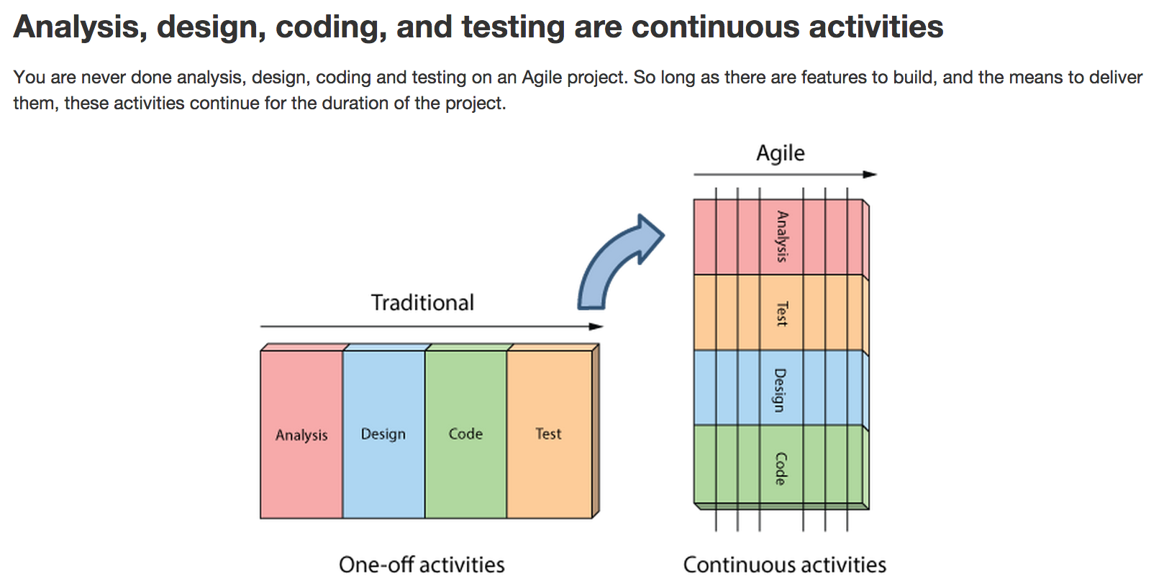
Agile Specifics

Slide 6
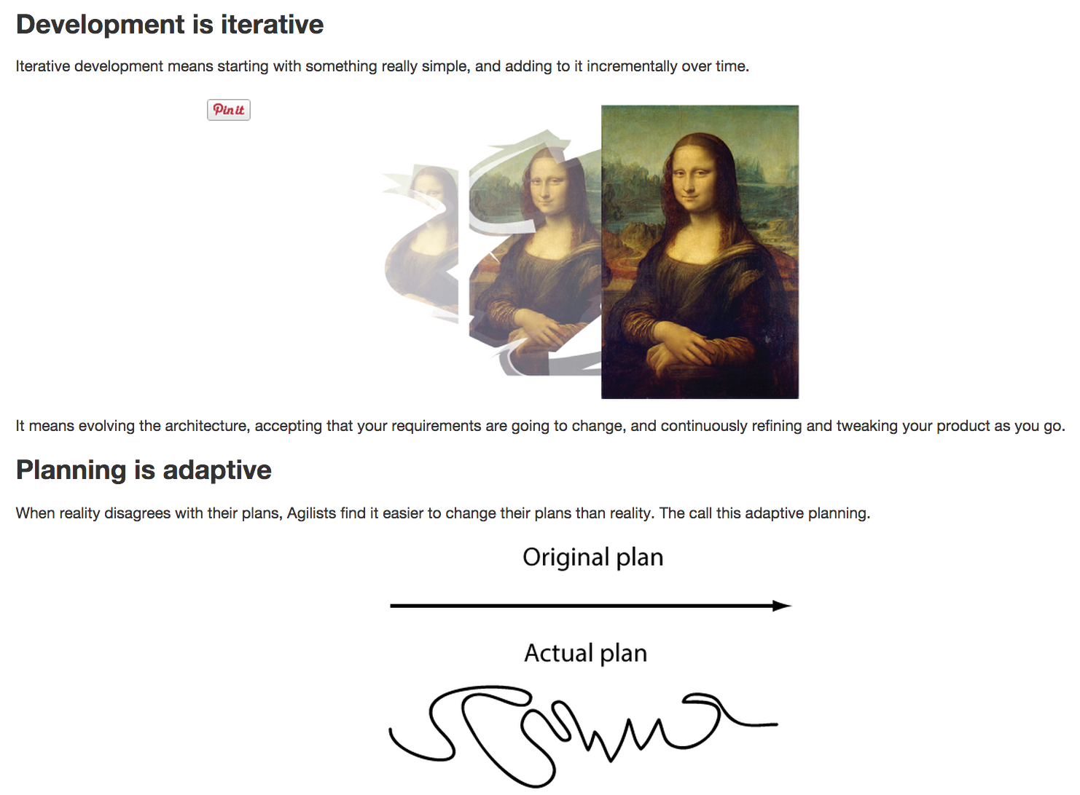
Agile Specifics

Slide 7
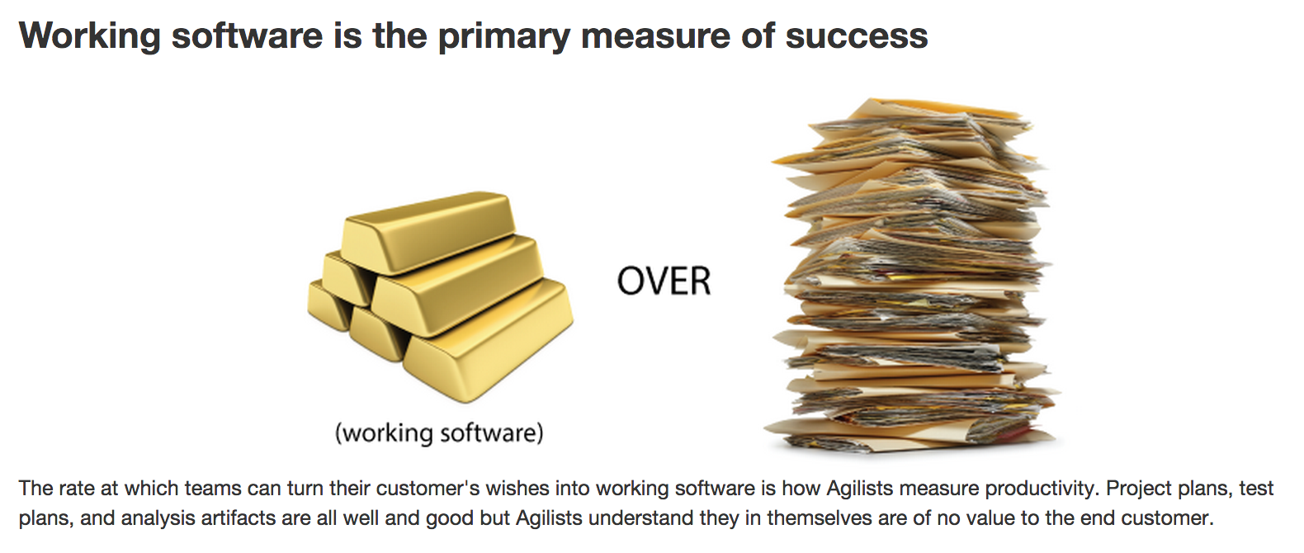
Agile Specifics

Slide 8
SCRUM intro

Slide 9
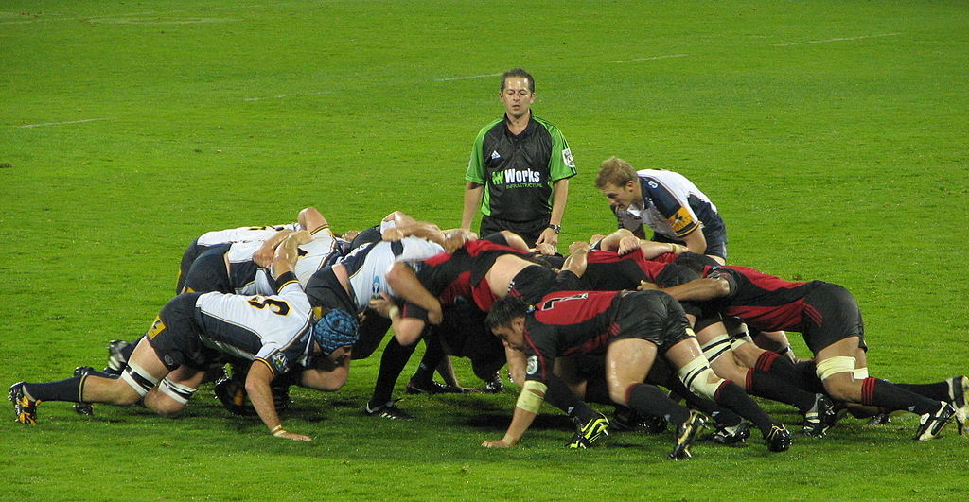
SCRUM intro
Notes:
Scrum is not an acronym – it is taken from the sport of Rugby, where everyone in the team pack acts together to move the ball down the field
Scrum – Iterative, incremental methodology for project management
Scrum is the framework which consists of a set of Scrum Teams and their associated roles; Time-Boxes, Artifacts, and Rules
Scrum Teams:
Self-organizing and cross-functional
Work in iterations
Consists of the following three roles:
Scrum Master, who is responsible for ensuring the process is understood and followed
Product Owner, who is responsible for creation and managing requirements
Team, which does the work

Slide 10
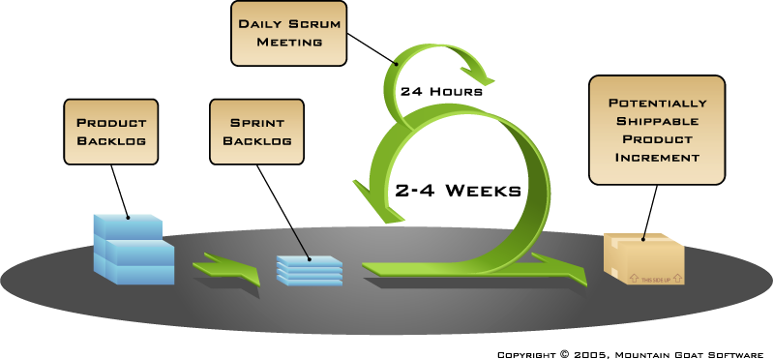
SCRUM intro

Slide 11
SCRUM intro
Analysis
Design
Development
Testing
Sprint 1
Sprint 2
Sprint 3
Sprint 4
Sprint 5
Sprint …
Release Cycle

Slide 12
SCRUM intro
Requirements
Design
Code
Test
Rather than doing all of one thing at a time…
...Scrum teams do a little of everything all the time

Slide 13
SCRUM Framework

Slide 14
SCRUM Framework
Roles
Product Owner
Scrum Master
Team
Time boxes
Sprint
Sprint planning
Daily Scrum
Sprint Review
Sprint Retrospective
Artifacts
Product Backlog
Sprint Backlog
Burndown Charts
Notes:
http://www.scrumguides.org/scrum-guide.html

Slide 15
SCRUM Framework: Roles
Roles
Product Owner
Scrum Master
Team
Time boxes
Sprint
Sprint Planning
Daily Scrum
Sprint Review
Sprint Retrospective
Artifacts
Product Backlog
Sprint Backlog
Burndown Charts
Notes:
The Scrum Team consists of the ScrumMaster, the Product Owner, and the Team.
Everyone else is a “chicken.” Scrum Team members are called “pigs.” The Product Owner is the “pig” of the Product Backlog.
The Team is the “pig” of the Sprint work. The ScrumMaster is the “pig” of the Scrum process.
Chickens cannot tell “pigs” how to do their work.
Chickens and pigs come from the story, “A chicken and a pig are together when the chicken says, "Let's start a restaurant!"
The pig thinks it over and says, "What would we call this restaurant?"
The chicken says, "Ham n' Eggs!"
The pig says, "No thanks, I'd be committed, but you'd only be involved!”

Slide 16

Product Owner
Defines the features of the product
Decides on release date and content
Responsible for the profitability of the product (ROI)
Prioritizes features according to market value
Adjusts features and priority every iteration, as needed
Accepts or reject work results
Notes:
Responsibilities:
Defines the features of the product
Decides on release date and content
Responsible for the profitability of the product (ROI)
Prioritizes features according to market value
Adjusts features and priority every iteration, as needed
Accepts or reject work results

Slide 17

SCRUM Master
Teaching the organization how to use Scrum;
Removing the barriers between the team and the customer;
Teaching the customer how to maximize ROI and meet their objectives;
Improving the lives of the development team by facilitating creativity and empowerment;
Improving the productivity of the development team in any way possible;
Improving the practices and tools so each increment of functionality is potentially shippable;
No authority;
Notes:
Responsibilities:
Teaching the organization how to use Scrum
Removing the barriers between the team and the customer.
Teaching the customer how to maximize ROI and meet their objectives.
Improving the lives of the development team by facilitating creativity and empowerment.
Improving the productivity of the development team in any way possible.
Improving the practices and tools so each increment of functionality is potentially shippable.
No authority
A Day In The Life:
Assess and ensure that everyone is aware of the project/ release/sprint goals;
Work with other ScrumMasters to ensure that organizational processes are being improved in order to better support teams;
Listen, and look for “Coachable Moments”;
Use all of your senses, including common sense, and remember that you have no authority.

Slide 18

Team
Typically 7+/-2 people
Cross-functional (Programmers, testers, user experience designers, etc.)
Members should be full-time (May be exceptions (e.g.: database administrator))
Teams are self-organizing (Ideally, no titles but rarely a possibility)
Membership should change only between sprints
Notes:
Typically 7+/-2 people
Cross-functional
Programmers, testers, user experience designers, etc.
Members should be full-time
May be exceptions (e.g.: database administrator)
Teams are self-organizing
Ideally, no titles but rarely a possibility
Membership should change only between sprints
Everyone necessary to go from product backlog to potentially shippable product increment, including:
Programmers
Testers
Analysts
DBAs
Tech Writers
UI Designers
Etc

Slide 19
SCRUM Framework: Time boxes
Roles
Product Owner
Scrum Master
Team
Time boxes
Sprint
Sprint Planning
Daily Scrum
Sprint Review
Sprint Retrospective
Artifacts
Product Backlog
Sprint Backlog
Burndown Charts

Slide 20
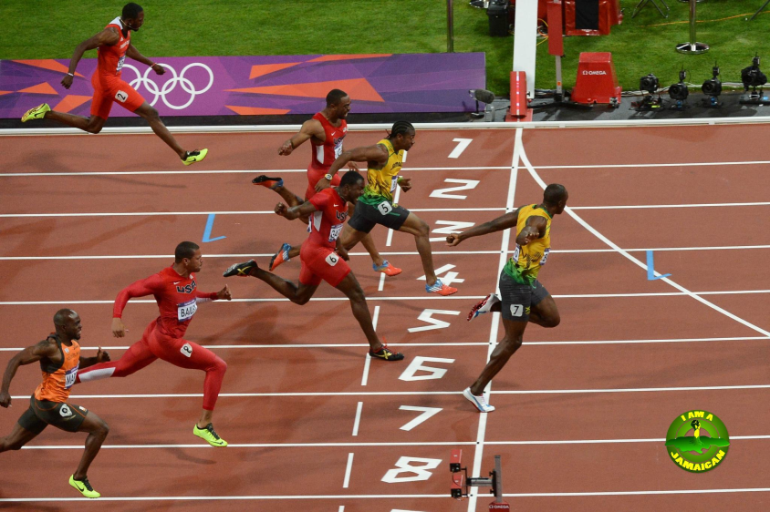
Sprint
2-4 weeks iteration
Team does work from product backlog
Team commits to achieve the sprint goal
Team plans work for sprint on a Sprint Planning Meeting
Team demos work completed on a Sprint Review Meeting
Every day team highlights progress on a Daily Scrum Meeting
Sprint Burndown chart is used to visualize team progress
Notes:
2-4 weeks iteration
Team does work from product backlog
Team commits to achieve the sprint goal
Team plans work for sprint on a Sprint Planning meeting
Team demos work completed on a Sprint Review Meeting
Every day team highlights progress on a Daily Scrum meeting
Sprint Burndown chart is used to visualize team progress

Slide 21
Sprint
Sprint planning
4/4 hrs.
Sprint Review and Retrospective
4/3 hrs.
Development Work
2-4 weeks sprint

Slide 22
Sprint
Abnormal Termination
Sprint can be cancelled
Sprint Goal becomes obsolete
Sprint no longer makes sense given the circumstances
If Sprint is terminated, next steps are:
Any ‘done’ Product Backlog items are reviewed to understand if they represent a potentially shippable increment
All other Product Backlog items are put back on the Product Backlog with their initial estimates. Any work done on them is assumed to be lost
Only the Product Owner has the authority to cancel the Sprint
Notes:
When a Sprint is cancelled, any completed and “done” Product Backlog items are reviewed. They are accepted if they represent a potentially shippable increment.
All other Product Backlog items are put back on the Product Backlog with their initial estimates. Any work done on them is assumed to be lost.
Sprint terminations consume resources, since everyone has to regroup in another Sprint planning meeting to start another Sprint.
Sprint terminations are often traumatic to the Team, and they are very uncommon.

Slide 23

Sprint Planning
Once per Sprint
8 hours for one month Sprint
Addresses two questions: What? and How?
Whole world is invited in order to provide technical or domain advice
Notes:
The Sprint Planning Meeting consists of two parts.
The first part is when what will be done in the Sprint is decided upon .
The second part (a four-hour time-box for a monthly Sprint) is when the Team figures out how it is going to build this functionality into a product increment during the Sprint.
There are two parts to the Sprint Planning Meeting: the “What?” part and the “How?” part. Some Scrum Teams combine the two.
In the first part, the Scrum Team addresses the question of “What?” Here, the Product Owner presents the top priority Product Backlog to the Team.
They work together to figure out what functionality is to be developed during the next Sprint. The input to this meeting is the Product Backlog, the latest increment of product, the capacity of the Team,
and past performance of the Team. The amount of backlog the Team selects is solely up to the Team. Only the Team can assess what it can accomplish over the upcoming Sprint.
In the second part of the Sprint Planning Meeting, the Team addresses the question of “How?” During the second part of the Sprint Planning Meeting (four hour time-box for a monthly Sprint), the Team figures out how it will turn the Product Backlog selected during Sprint Planning Meeting (What) into a done increment. The Team usually starts by designing the work. While designing, the Team identifies tasks. These
tasks are the detailed pieces of work needed to convert the Product Backlog into working software. Tasks should have decomposed so they can be done in less than one day. This task list is called the Sprint
Backlog. The Team self-organizes to undertake the work in the Sprint Backlog, either during the Sprint Planning meeting or just-in-time during the Sprint.

Slide 24
Sprint Planning
Sprint Planning Meeting
Sprint Prioritization
Analyze and evaluate Product Backlog
Select sprint goal
Team
Capacity
Sprint
Goal
Product
Backlog
Sprint Planning
Decide how to achieve sprint goal (design)
Create sprint backlog (tasks) from product backlog items (user stories / features)
Estimate sprint backlog in hours
Sprint
Backlog
Technology

Slide 25
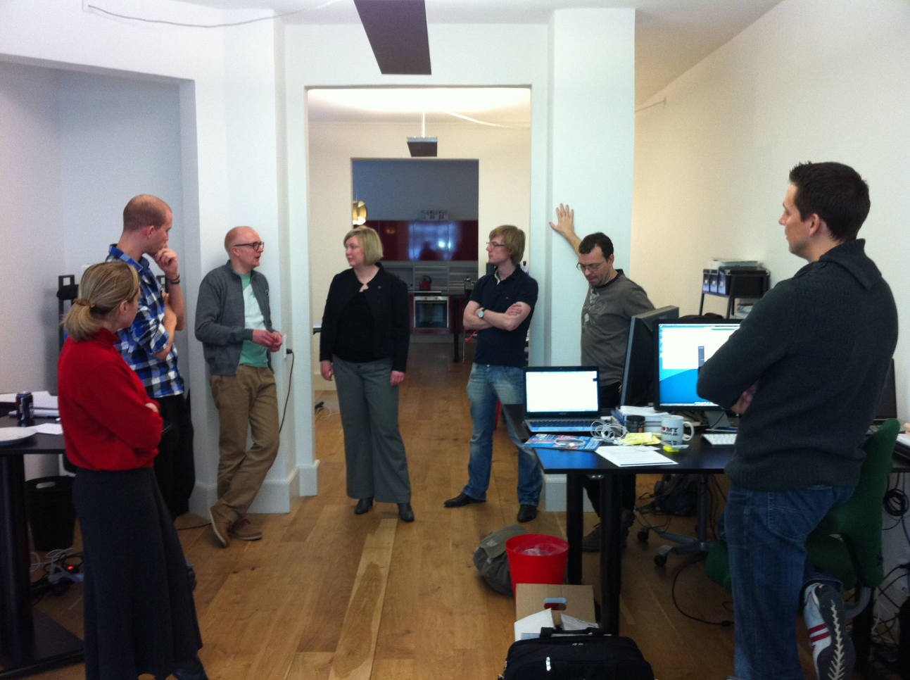
Daily SCRUM
Daily
15-minutes
Stand-up
Whole world is invited
Only Team, Scrum Master, Product Owner can talk
Notes:
Parameters
Daily
15-minutes
Stand-up
Not for problem solving!
Whole world is invited
Only Team, Scrum Master, Product Owner can talk
Helps avoid other unnecessary meetings

Slide 26
Daily SCRUM
Everyone answers 3 questions, which aren’t not status for the Scrum Master, but they are commitments in front of peers
1
What has been accomplished since the last meeting?
2
What is going to be done before the next meeting?
3
Is anything on your way?
Notes:
Daily Scrums improve communications, eliminate other meetings, identify and remove impediments to development, highlight and promote quick decision-making, and improve everyone's level of project knowledge.
The ScrumMaster ensures that the Team has the meeting.
The Team is responsible for conducting the Daily Scrum.
The ScrumMaster teaches the Team to keep the Daily Scrum short by enforcing the rules and making sure that people speak briefly.
The ScrumMaster also enforces the rule that chickens are not allowed to talk or in anyway interfere with the Daily Scrum.
The Daily Scrum is not a status meeting. It is not for anyone but the people transforming the Product Backlog items into an increment (the Team).
The Team has committed to a Sprint Goal, and to these Product Backlog items.
The Daily Scrum is an inspection of the progress toward that Sprint Goal (the three questions). Follow-on meetings usually occur to make adaptations to the upcoming work in the Sprint.
The intent is to optimize the probability that the Team will meet its Goal. This is a key inspect and adapt meeting in the Scrum empirical process.

Slide 27

Sprint Review
Once per Sprint
4 hours for one month Sprint
Team presents what it accomplished during the sprint
Whole team participates
World is invited!
Notes:
What happens on Sprint Review?
Team presents what it accomplished during the sprint
Typically takes the form of a demo of new features or underlying architecture
Informal
4-hour prep time rule (for 4-week sprint)
No slides
Whole team participates
World is invited!
The meeting includes at least the following elements:
The Product Owner identifies what has been done and what hasn’t been done.
The Team discusses what went well during the Sprint and what problems it ran into, and how it solved these problems.
The Team then demonstrates the work that is done and answers questions.
The Product Owner then discusses the Product Backlog as it stands. He or she projects likely completion dates with various velocity assumptions.
The entire group then collaborates about what it has seen and what this means regarding what to do next.
The Sprint Review provides valuable input to subsequent Sprint Planning meeting.
What happens after Sprint Review?
Unfinished work goes to the Product Backlog
Update the Product Backlog based on work completed by the team – expected and unexpected
Reformulate the team – do we have the “right” team members for the next sprint
Reprioritizing the Product Backlog to take advantage of opportunities that the completed work presents
Requesting that the project progress be sped up by authorizing additional teams to work on the Product Backlog

Slide 28

Sprint Retrospective
Once per Sprint
3 hours for one month Sprint
To revise development process to make it more effective and enjoyable for the next Sprint
Whole team participates
Notes:
Takes place after the Sprint Review and prior to the next Sprint Planning meeting.
The purpose of the Retrospective is to inspect how the last Sprint went in regards to people, relationships, process and tools.
The inspection should identify and prioritize the major items that went well and those items that-if done differently-could make things even better.
These include Scrum Team composition, meeting arrangements, tools, definition of “done,” methods of communication, and processes for turning Product Backlog items into something “done.”
By the end of the Sprint Retrospective, the Scrum Team should have identified actionable improvement measures that it implements in the next Sprint.
These changes become the adaptation to the empirical inspection.

Slide 29
Sprint Retrospective
Whole team gathers and discusses what they’d like to:
Start doing
Continue doing
Stop doing
Team tries to fix 3-5 the most important items during the next sprint
At the beginning of each retrospective meeting team reviews items that were selected previous time
Notes:
What to do?
Team selects 3-5 most important items to address
Team tries to fix important items during the next sprint
At the beginning of each retrospective meeting team reviews items that were selected previous time

Slide 30
SCRUM Framework: Artifacts
Roles
Product Owner
Scrum Master
Team
Time boxes
Sprint
Sprint Planning
Daily Scrum
Sprint Review
Sprint Retrospective
Artifacts
Product Backlog
Sprint Backlog
Burndown Charts
Notes:
Scrum Artifacts include the Product Backlog, the Release Burndown, the Sprint Backlog, and the Sprint Burndown.

Slide 31

Product Backlog
The requirements for the product
A list of all desired work on the project (enhancements, functions, bug fixes)
Ideally expressed such that each item has value to the users or customers of the product
Prioritized by the product owner
Reprioritized at the start of each sprint
This is the Product Backlog
Notes:
The requirements for the product that the Team(s) is developing are listed in the Product Backlog.
The Product Owner is responsible for the Product Backlog, its contents, its availability, and its prioritization.
Product Backlog is never complete.
The initial cut at developing it only lays out the initially known and best-understood requirements. The Product Backlog evolves as the product and the environment in which it will be used evolves.
The Backlog is dynamic in that it constantly changes to identify what the product needs to be appropriate, competitive, and useful.
As long as a product exists, Product Backlog also exists.
Product Backlog items have the attributes of a description, priority, and estimate. Priority is driven by risk, value, and necessity.

Slide 32
Product Backlog Example
Backlog item | Estimate (story points)
As a house owner, I want to see Christmas Tree in living room, so that to celebrate the Christmas | 8
As a house owner, I want to have New Year decorated windows, so that people can see nice windows from the outside | 5
As a guest, I want to have sitting place, so that to have a rest during celebration | 1
As a guest, I want to have ability to listen the music, so that I can dance | 3
As a guest, I want to have different dishes on the holiday table, so that do not be hungry on celebration | 21
... | 30
Notes:
Requirements never stop changing. Product Backlog is a living document.
Changes in business requirements, market conditions, technology, and staffing cause changes in the Product Backlog.
To minimize rework, only the highest priority items need to be detailed out.

Slide 33
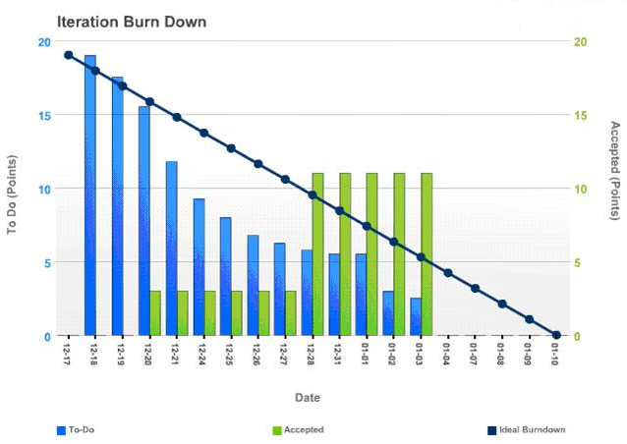
Release Burndown
Records the sum of remaining Product Backlog estimated effort across time
Initial estimates can be changed
Trend line is drawn based on the changes in remaining work
The Team is responsible for all estimates
Notes:
The Release Burndown graph records the sum of remaining Product Backlog estimated effort across time. The estimated effort is in whatever unit of work the Scrum Team and organization have decided upon. The units of time are usually Sprints.
Product Backlog item estimates are calculated initially during Release Planning, and thereafter as they are created.
During Product Backlog grooming they are reviewed and revised. However, they can be updated at any time.
The Team is responsible for all estimates. The Product Owner may influence the Team by helping understand and select trade-offs, but the final estimate is made by the Team.
The Product Owner keeps an updated Product Backlog list Release Backlog Burndown posted at all times.
A trend line can be drawn based on the change in remaining work.

Slide 34
Sprint Backlog
Tasks the Team performs to turn Product Backlog items into a “done” increment
All of the work that the Team identifies as necessary to meet the Sprint goal
Team modifies Sprint Backlog throughout the Sprint (Adds tasks, estimates remaining work, delete tasks)
This is the Sprint Backlog
Only the Team can change its Sprint Backlog during a Sprint.
Only the Team can change the contents or the estimates.
Notes:
The decomposition is enough so changes in progress can be understood in the Daily Scrum. One day or less is a usual size for a Sprint Backlog item that is being worked on.
The Team modifies Sprint Backlog throughout the Sprint, as well as Sprint Backlog emerging during the Sprint.
As it gets into individual tasks, it may find out that more or fewer tasks are needed, or that a given task will take more or less time than had been expected.
As new work is required, the Team adds it to the Sprint Backlog.
As tasks are worked on or completed, the estimated remaining work for each task is updated.
When tasks are deemed unnecessary, they are removed.

Slide 35
Sprint Backlog Example
Tasks | Mon | Tue | Wed | Thur | Fri
As a house owner, I want to see Christmas Tree in living room, so that to celebrate the Christmas
Select and measure a place for the Christmas Tree | 1 | 0 | 0 | 0 | 0
Select color, size and style for Christmas decorations (toys, Christmas tree ornaments etc) | 3 | 0 | 0 | 0 | 0
Buy Christmas Tree | 4 | 0 | 0 | 0 | 0
Buy Christmas decorations | 8 | 8 | 6 | 7 | 0
Install Christmas Tree | 0.5 | 0.5 | 0.5 | 0 | 0
Decorate the Christmas Tree | 3 | 3 | 3 | 3 | 3
As mother to take a look if this is what she expected | 0.5 | 0.5 | 0.5 | 0.5 | 0.5

Slide 36
Sprint Burndown Chart
Story Points
Days in Sprint
Notes:
Sprint Backlog Burndown is a graph of the amount of Sprint Backlog work remaining in a Sprint across time in the Sprint.
To create this graph, determine how much work remains by summing the backlog estimates every day of the Sprint. The amount of work remaining for a Sprint is the sum of the work remaining for all of
Sprint Backlog. Keep track of these sums by day and use them to create a graph that shows the work remaining over time. By drawing a line through the points on the graph, the Team can manage
its progress in completing a Sprint’s work. Duration is not considered in Scrum. Work remaining and date are the only variables of interest. One of Scrum's rules pertains to the purpose of each Sprint, which is
to deliver increments of potentially shippable functionality that adheres to a working definition of “done.”

Slide 37
User Story
As a <type of user>, I can <goal> so that <reason>
As a guest, I want to have sitting place to have a rest during celebration
As a house owner, I want to see Christmas Tree in living room, to celebrate the Christmas
As a guest, I want to have ability to listen the music so that I can dance
Notes:
User Stories are short, clear description of the functionality that will be valuable for the customer or user of the product
User story include Acceptance Criteria
Benefits of User Stories:
Stories shift focus from writing to talking
Stories are understandable by users and developers
Stories support iterative development
Stories are the right size for planning
Characteristics:
Independent
Negotiable
Valuable
Estimatable
Small
Testable

Slide 38

Definition of “Done”
Increment built during Sprint must be potentially shippable, so it must be “done”.
An example of “Done”:
Coded / implemented
Peer reviewed
Code is run against current version in source control
Code is commented in source control and checked in
Test Case Specifications are updated and executed with no failures
All critical and blocker bugs found, resolved and verified
Unit Tests written and passing (0 failing in your build components)
Notes:
Scrum requires Teams to build an increment of product functionality every Sprint. This increment must be potentially shippable, for Product Owner may choose to immediately implement the functionality.
To do so, the increment must be a complete slice of the product. It must be “done.” Each increment should be additive to all prior increments and thoroughly tested, ensuring that all increments work together.
When someone describes something as done, everyone must understand what done means.
Done defines what the Team means when it commits to “doing” a Product Backlog item in a Sprint.
Some products do not contain documentation, so the definition of “done” does not include documentation.
A completely “done” increment includes all of the analysis, design, refactoring, programming, documentation and testing for the increment and all Product Backlog items in the increment.
Testing includes unit, system, user, and regression testing, as well as non-functional tests such as performance, stability, security, and integration.
Done includes any internationalization.
Some Teams aren’t yet able to include everything required for implementation in their definition of done. This must be clear to the Product Owner. This remaining work will have to be done before the product can be implemented and used.

Slide 39

Estimation and Planning
Story points – type of estimation of the effort of product backlog items
Velocity – is how much product backlog effort a team can handle in one sprint
Number of story points to be “Done”
Incomplete stories don’t count

Slide 40
Estimation and Planning
How to evaluate user story?
The “bigness” of user story
Unit-less values
Relative values
Typically Fibonacci numbers are used:
1, 2, 3, 5, 8, 13…
Other options
T-Shirt sizes: XS, S, M, L, XL, …

Slide 41
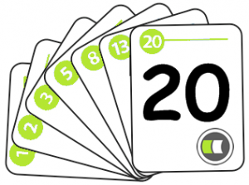
Planning Poker
Planning Poker – is a consensus-based technique for estimating!
Each estimator is given a deck of cards, each card has a valid estimate written on it
Product Owner reads a story and it’s discussed briefly
Each estimator selects a card that’s his or her estimate
Cards are turned over so all can see them
Discuss differences (especially outliers)
Re-estimate until estimates converge
Notes:
References:
http://en.wikipedia.org/wiki/Planning_poker

Slide 42
Thank you
US OFFICES
Austin, TX
Fort Myers, FL
Boston, MA
Newport Beach, CA
Salt Lake City, UT
EUROPE OFFICES
United Kingdom
Germany
The Netherlands
Ukraine
Bulgaria
EMAIL
info@softserveinc.com
WEBSITE:
www.softserveinc.com
USA TELEPHONE
Toll-Free: 866.687.3588
Office: 239.690.3111
UK TELEPHONE
Tel: 0207.544.8414
GERMAN TELEPHONE
Tel: 0692.602.5857

